Slide 1
COMPANY PRESENTATION
AKABI GROUP

Slide 2




WHO we are
2011
120
START DATE
COLLABORATORS
3
3
COUNTRIES
DIVISIONS

Slide 3
AKA
stands for « Also Known As »
stands for « Red » in Japanese, the color of passion and ambition
BI
stands for our 3 divisions: Business Intelligence, Business Innovation and Business Integration

Slide 4



Our 3 divisions
Business Innovation
Business Intelligence
Business Integration
Digital technologies and management
Integrating and reporting customers data
Implementing cloud and private server platforms

Slide 5































Business intelligence

Slide 6

A new department !
Extract meaningful insights from data
Apply machine learning algorithms to numbers, text, images, videos and audios
Learn by example (model training) from historical data to predict outcomes and uncover patterns
Churn detection
Predictive analytics
Data Science & Machine Learning
AI

Slide 7











Business innovation
Mobile
Development
Web
Development
Project
Management
Innovation
Experts

Slide 8

















Business integration
Cloud Technologies
Systems
Virtualization
DevOps

Slide 9



Our services
Contracting & Staffing
All our consultants are continuously trained by AKABI and can work on medium or long-term missions, onsite in our client’s offices or remotely from AKABI’s offices
Project / POC
Our consultants can work on your projects in a fixed price model.
They can implement projects like POC, technical analysis, data warehouse implementation, digital development, …
Our main objective is to provide the best engineers on the market to make your projects a success !

Slide 10


Our values
Human first
Quality
Transparency
We don’t hire skills, we hire humans ! From the sourcing phase to the management of the career at AKABI, our investment in our teams is strong and constantly evolving.
We prefer to invest in quality rather than in quantity, expressing realistic and qualitative expansion of our company.
We believe that good communication is the basis for a successful business. The collaboration between AKABI, its clients and consultants is based on a totally transparent approach.

Slide 11


Our values
Eco-responsible
Nature and ecology are one of the most important challenges of our century. AKABI is proud to be a carbon-neutral company.

Slide 12


Our values
Fun
At AKABI, we believe that a good work environment contributes to awesome results. We know how to combine fun and hard work !

Slide 13











Akabi is a best place to work

Slide 14



Our engagements
Ensure the best service by providing the best talents to our customers.
Scale-up fast to follow our customer’s activities.
Respond to our customer’s requests in a short period of time.

Slide 15



























Our customers

Slide 16

Real-Time Voice Transcription

Slide 17
The Luxembourg government faces an urgent need to automate the transcription of press conferences to improve the diffusion of public information
Challenges
Manual Transcription and Translation in Multilingual Press Conferences
Significant Delays
Manual transcriptions delay the publication of press conferences. This penalizes quick access to crucial information and is not suitable for emergency situations or important announcements
Multilingualism
Multilingual conferences require additional manual translation
The manual translation process extends the publication delay
Costly Resources
Costly mobilization of resources for transcription and translation
High costs for the government and human errors

Slide 18
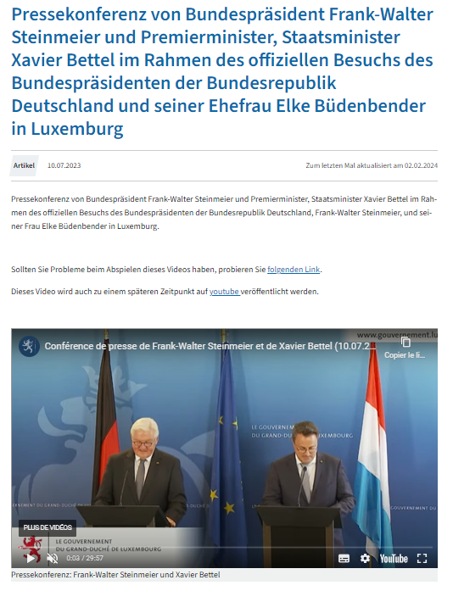
Current manual transcriptions delay the publication of information, reducing its accessibility
80%
80% of press conferences are manually transcribed by the Service Information Presse du Gouvernement
30%
30% of conferences cover topics requiring rapid diffusion
4
Press conferences are held in 4 languages: Luxembourgish, French, German, English
>1h
The average manual transcription delay ranges from several hours to several days

Slide 19



AKABI is implementing a real-time transcription solution based on fine-tuned AI models for Luxembourgish and other European languages
Performance
Artificial Intelligence Models
Business Impact
Low latency transcription (<500ms)
Real-time multilingual management
Automatic language switching
Integration into live streams (YouTube, Facebook)
OpenAI's Whisper
Lemswasabi
ZLS
Voxlingua107
AI automation of the transcription process
Archived videos benefit from transcriptions
Automatic Speakers separation
Diffusion of critical information without delay
Reduction of operational costs related to manual transcription
Notes:
Secure deployment: Leveraged Azure OpenAI to implement a scalable, secure, and compliant infrastructure for AI use across the organization.

Slide 20



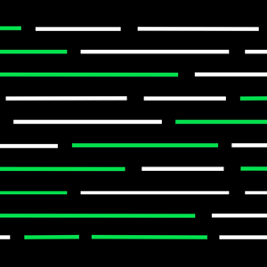





A robust and specialized technical stack to support real-time multilingual transcription
1x Senior Data Scientist (6 months) 1x Medior Data Scientist (3 months) 1x Medior Data Engineer (3 months)
Hugging Face Whisper PyTorch GPT-4 Streamlit Flutter TensorFlow Anaconda JupyterLab

Slide 21

Semantic Search

Slide 22
Users of MyGuichet.lu face challenges finding relevant information quickly and accurately
10 992 pages
MyGuichet.lu hosts over 10,992 pages of administrative information in three languages, making it difficult for users to find precise answers to their queries.
Natural Language
Users expect a seamless search experience that goes beyond simple keyword matching, delivering contextually relevant results that address their specific needs, such as tax forms or local administrative procedures in the user’s natural language or own words
3 languages
With users from different linguistic backgrounds, the portal must handle queries in Luxembourgish, French, Portuguese, and other languages while ensuring accurate and reliable responses

Slide 23
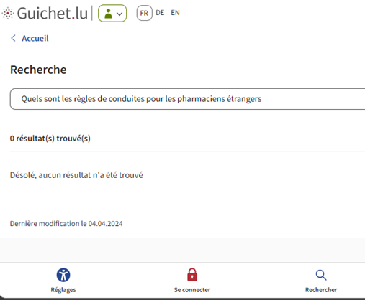
Existing search functionalities fail at capturing the meaning of the user query
Poor user experience
Search queries like "Quels sont les règles de conduite pour les pharmaciens étrangers" returns 0 result on Guichet.lu, despite relevant information being available on the platform
0
No understanding of the query
No understanding of the real semantic meaning of the user query
Current solutions fail to manage multilingual content or understand the semantic nuances of queries mixing multiple languages, leading to poor user experience
No Multilingual, context-aware search

Slide 24

A semantic search solution enhances user experience by improving accuracy, speed, and multilingual capabilities
Results
Models
User Impact
Context-aware search and retrieve
Scalable deployment: Docker with CI/CD enables rapid deployment in under 5 minutes
Text embedding models:
Hybrid search: Vector Search & BM25
Semantic search combined with Keywords search
Faster Response
Better precision and recall on the responses
Increased user experience
Better access the information by the user

Slide 25









A robust and specialized technical stack to support natural language queries
1x Senior Data Scientist (6 months) 1x Expert Developer (6 months) 1x Expert Data Engineer (6 months)
ChromaDB Django Flutter GPT Hugging Face JupyterLab LangChain LlamaIndex LLM (Large Language Model) NLP (Natural Language Processing) Pinecone Streamlit

Slide 26
Annexe

Slide 27


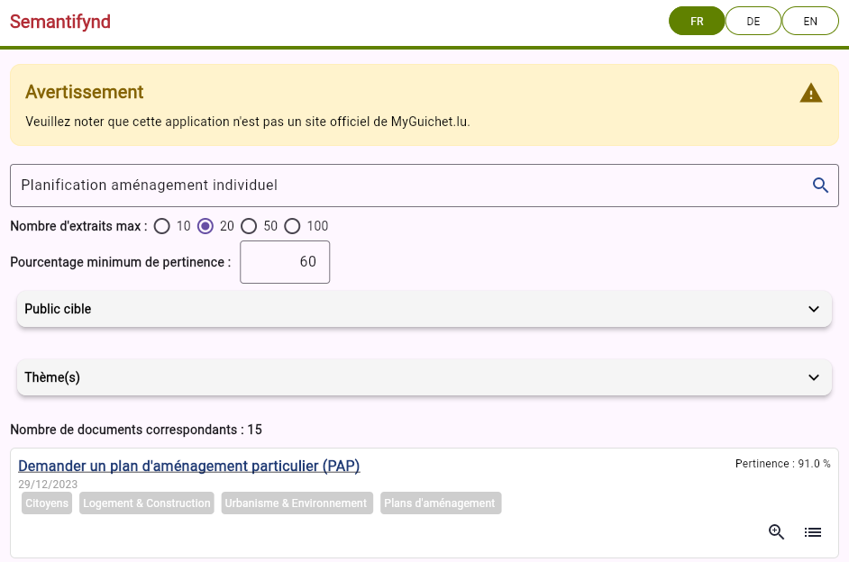

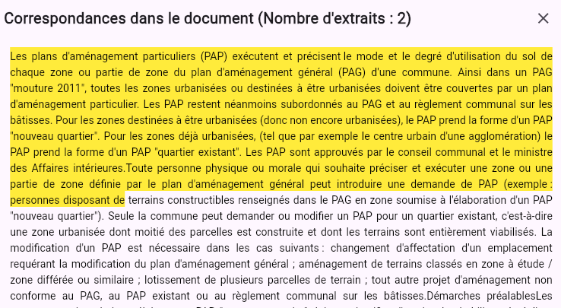




Functional view
Response
R.A.G
LLM
Corpus : web pages from guichet.lu
Question:
« Planification aménagement individuel »

Slide 28
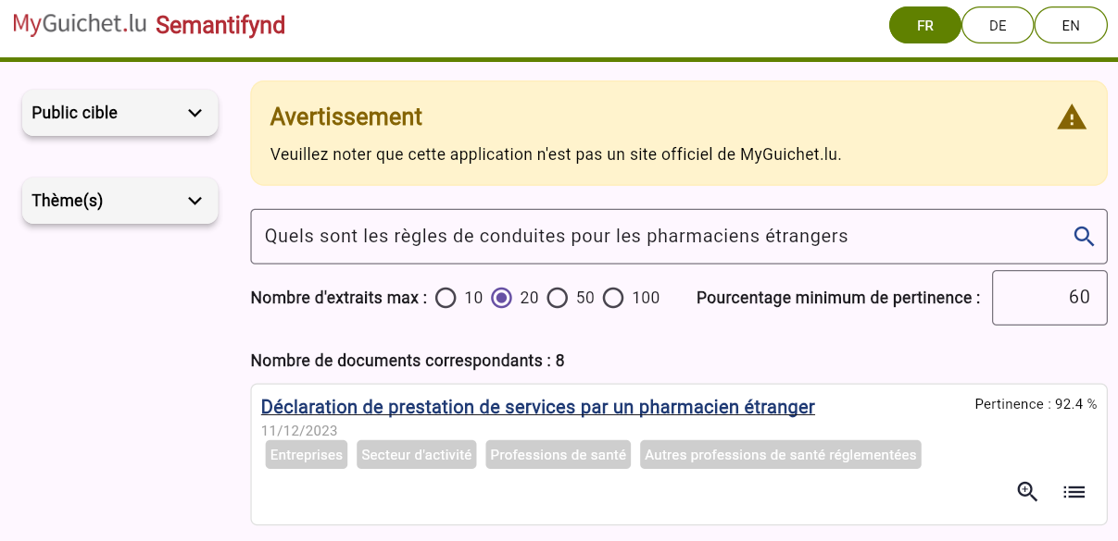
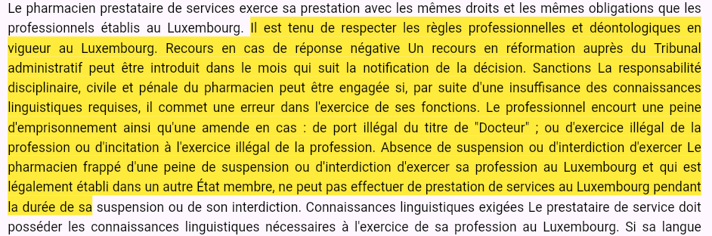
Response to a complex query
Response to a complex query that requires a nuanced semantic understanding to provide relevant results
Our solution handles keywords, context, and the meaning behind a query

Slide 29
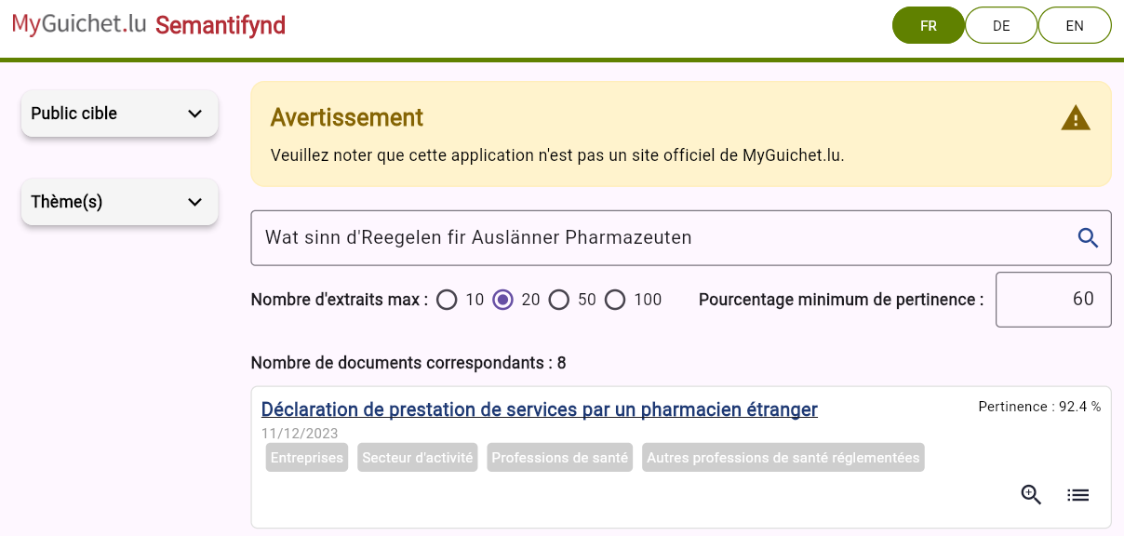
Response to a complex query
Response to the same complex query in Luxembourgish Wat sinn d'Reegelen fir Auslänner Pharmazeuten

Slide 30
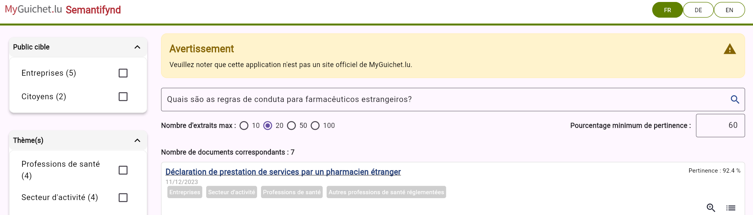
Response to a complex query
Response to the same complex query in Portuguese Quais são as regras de conduta para farmacêuticos estrangeiros?

Slide 31
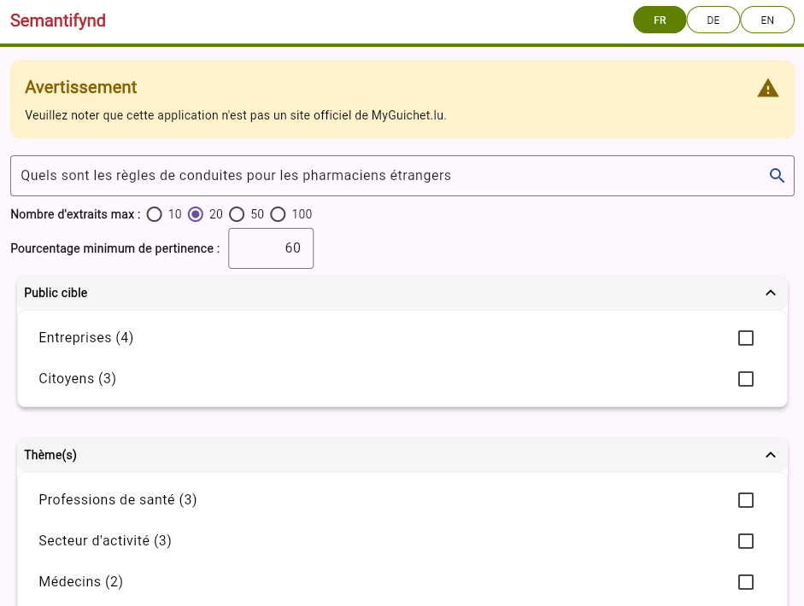
Home interface
Languages
Question input area
Automatic filters

Slide 32
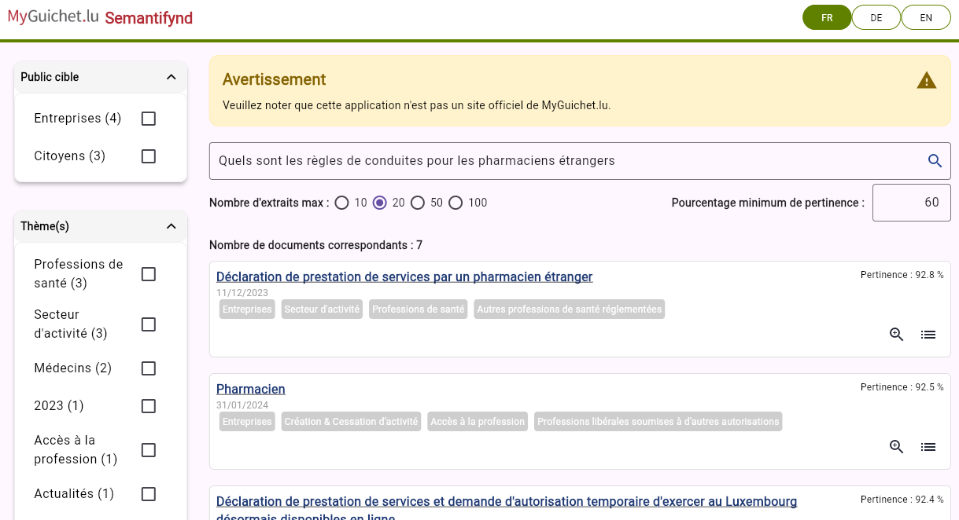
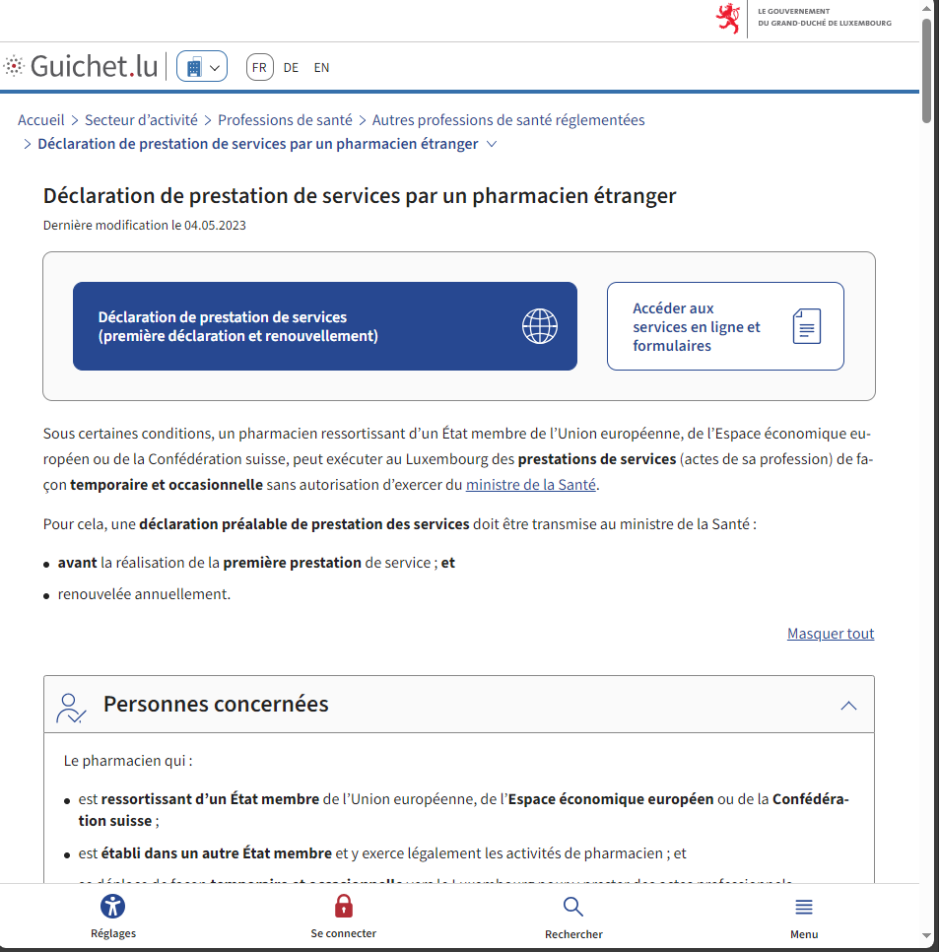
Results presentation
Relevance minimal score
Relevance score
Results list

Slide 33
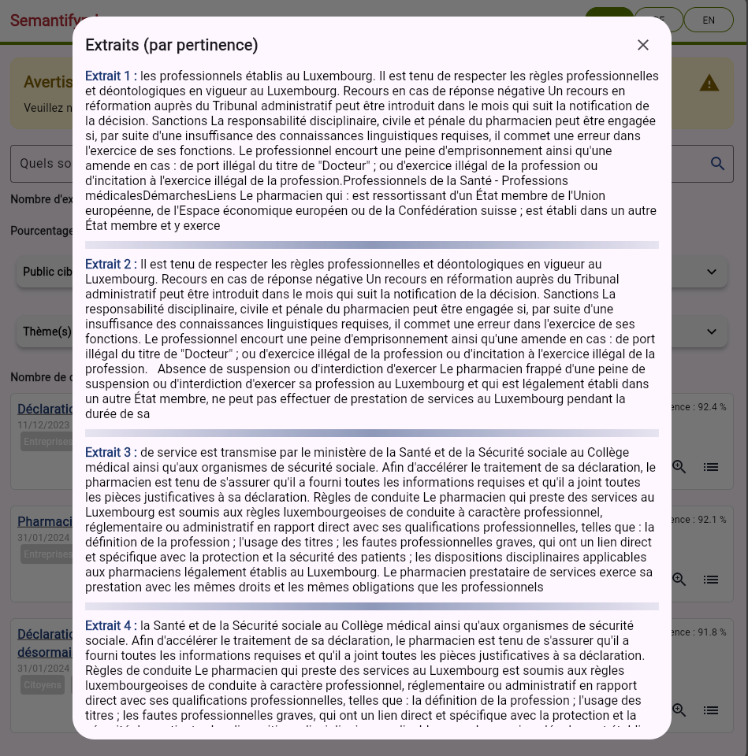
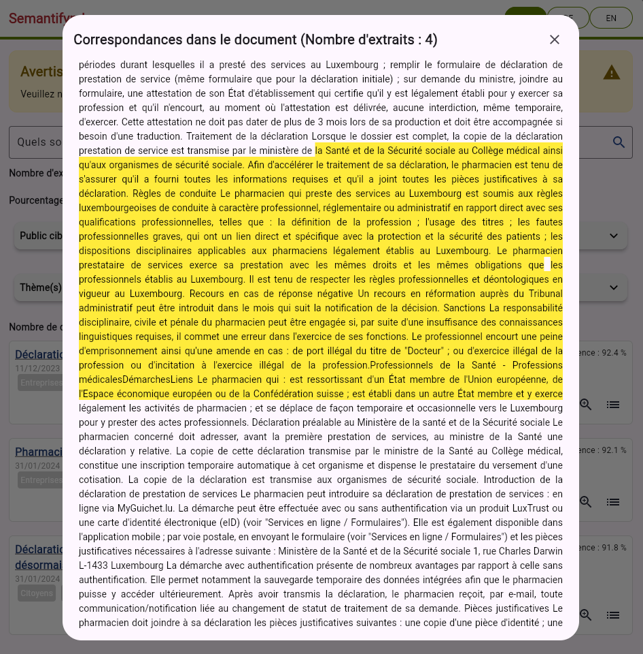
Detailed results presentation
Relevant Extracts
Highlight of relevant extracts

Slide 34
Functional view
Response
R.A.G
LLM
Corpus : web pages from guichet.lu
Question:
« Planification aménagement individuel »

Slide 35
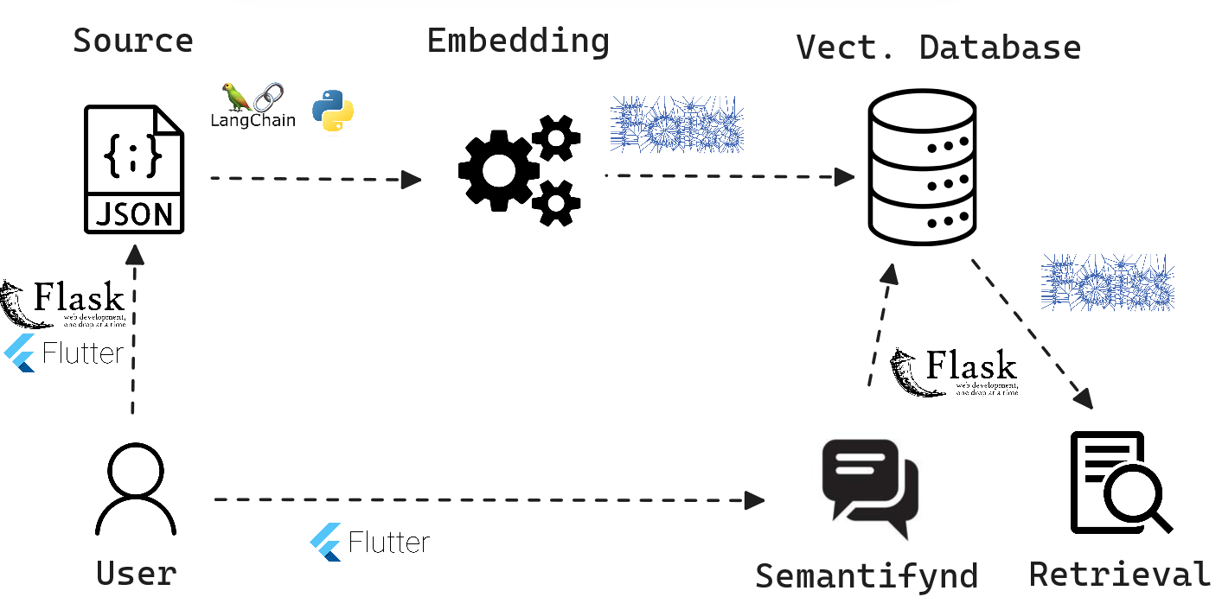
Technical View

Slide 36
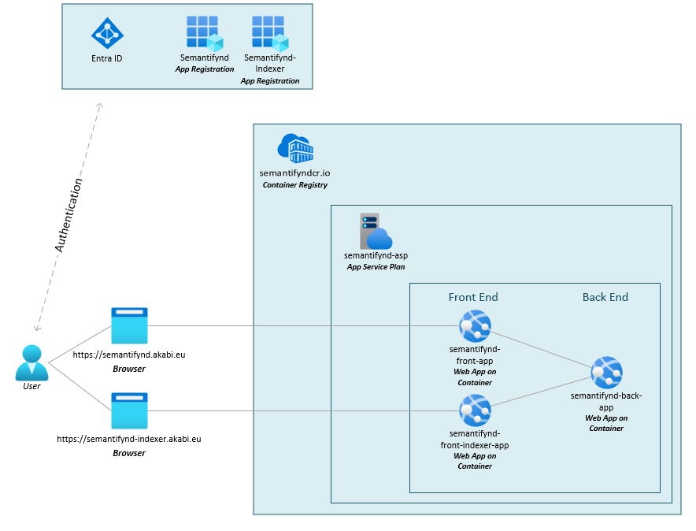
Architecture Diagram
Docker automatically deployed via CI/CD
Solution deployable in 5 minutes via a pipeline
Complete and easily scalable solution on OpenShift-type infrastructure

Slide 37

AXA Secure GPT Deployment

Slide 38
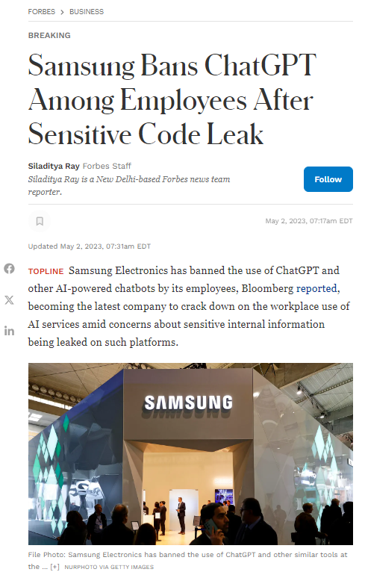
AXA faces a strategic need to integrate generative AI technologies while ensuring maximum security and strict compliance with regulatory frameworks
Risk
Data-privacy compliant environment
AXA aims to protect sensitive customer data while leveraging the benefits of generative AI across its global workforce of 140,000 employees
Reputational Damage and Loss of Trust
Inaccurate or biased responses, especially in critical functions like claims management or underwriting could erode customer trust
Data Breaches and Privacy Violations
Misuse of ChatGPT can lead to breaches of sensitive customer data, which could result in heavy financial penalties

Slide 39



The challenges of implementing Generative AI in a highly regulated environment
A secured data journey
Ensure Compliance with AXA Security comities
Build Awareness on Generative AI
While leveraging a secure tenant on Azure, the isolation needed to maintain data confidentiality limits flexibility. This isolation introduces complexities in scaling the integration with broader AI applications
For AXA Secure GPT to be fully implemented, the solution must pass through all security committees within AXA. This rigorous approval process ensures that the system complies with the company’s stringent data protection and cybersecurity protocols​
Drive engagement and understanding of Generative AI across global teams
Notes:
Sources:
https://masterofcode.com/blog/chatgpt-statistics
AI and ChatGPT can help insurers improve the claims experience (lifeinsuranceinternational.com)

Slide 40
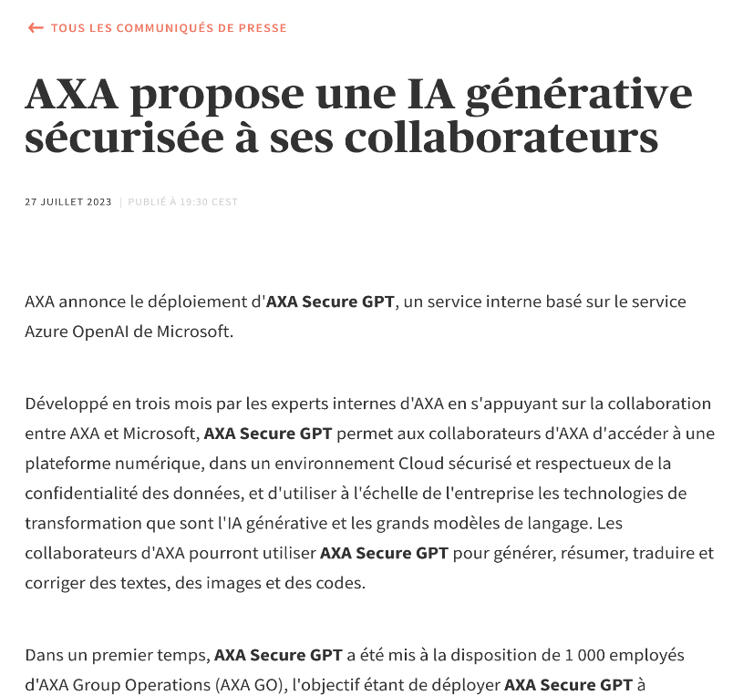


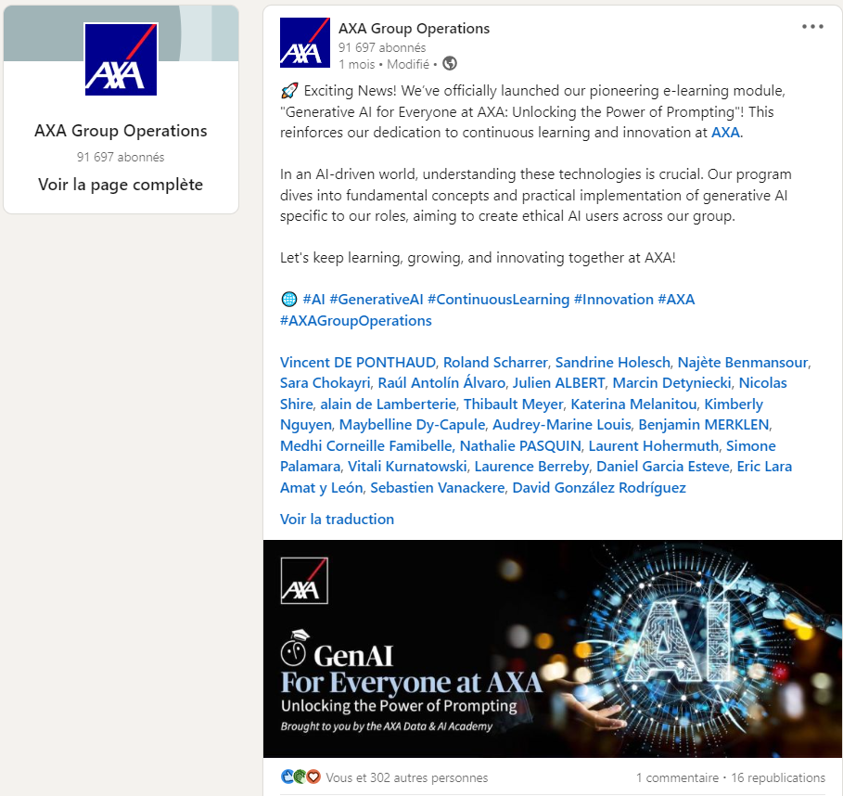
AXA Secure GPT enhances AI deployment with a focus on security
86%
Achieved 86% adoption among AXA HQ employees
Launched the Generative AI for Everyone at AXA e-learning module
Leveraged Azure OpenAI to implement a scalable, secure, and compliant infrastructure for AI use across the organization
35K
Assisting 35 000 employees (expanding to 100 000.) across various functions, enhancing efficiency, document drafting, underwriting, etc.

Slide 41




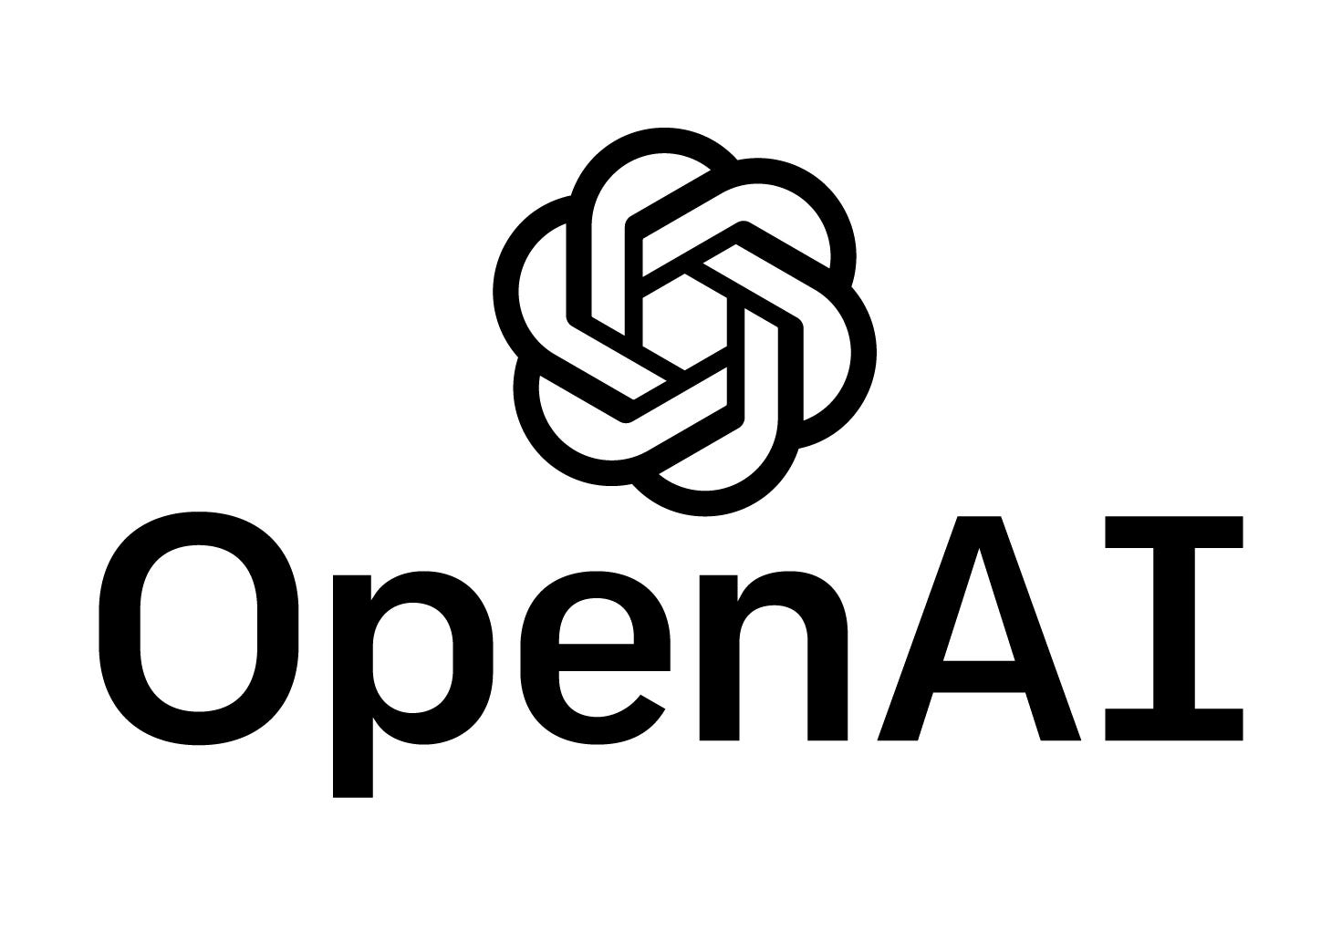

Secure GPT & Generative AI
2x Senior Data Scientist (10 months)
GPT Azure DevOps LangChain Azure Data Lake SharePoint Framework Python

Slide 42
Retrieval-Augmented Generation for Subjects matter experts

Slide 43
AXA employees deal with an overwhelming volume of information from various sources and formats
Risk
Large and diverse documents
Annual reports, regulations or minutes can be several hundred pages long. Depending on the department, employees may need to analyze videos, charts, etc.
Human errors
Increasing volume of documents
Data Breaches due to Shadow AI
Vast amount of sources
The corpus of data handled by AXA’s financial analysts is large and highly varied, encompassing reports, regulations, and market analyses across different formats and sources
Data Breaches
External RAG solution can lead to leakage of sensitive data therefore cannot be used by employees

Slide 44
Overcoming data complexity and ensuring security in the implementation of AI for financial analysis
A secured data journey
Ensure Compliance with AXA Security comities
Informed Decision-Making
Using advanced multimodal model like GPT-4o, the application can read images, charts, etc.
Secure the analyst queries
The RAG application use the company’s LLM through Secure GPT to mitigate the risk of data leakage
Documents and embeddings are stored on AXA’s private Azure cloud as requested by Security and Data privacy teams
Employees can generate more accurate and timely outputs based on real-time insights and a better understanding of large, complex datasets

Slide 45
Enhancing financial analysts' productivity and decision with a secure RAG solution
4
Benchmark of 4 RAG solutions offered by software editors
RAG Solution drastically reduces the time spent manually analyzing large documents, such as 500-page financial reports or market analyses, by quickly retrieving and summarizing relevant data or figure
By integrating reliable data sources, RAG enhances the precision of the information used for financial decisions, reducing the risk of oversight or human error
200+
200+ use cases identified for the Secure RAG proposition across all departments

Slide 46






AUTOMATED CREDIT ASSESSMENT
CV
CV
CV
Rationale
Business teams
Input
Credit analysts spend a significant amount of time analyzing public documents (annual reports, rating reports, etc.) to produce their internal Credit Assessment reports. Data privacy analysts must go through the documents to understand each article, rules and implement the required changes.
AXA GIE’ credit analyst
For each company/country to assess, less than 50 documents are used. PPTx, PDF, annual reports, press releases, rating agencies reports, press articles, etc.
Detailed use case description
Benefits
Output content
Analysts spend time reading and analyzing reports to form an opinion (more than 100 pages for each report). Finding relevant info in a reports that are more than 100 pages consume a lot of time.
RAG, through its use of AXA’s LLM models help Credit Analysts to run semantic search (vs. keywords search) and find the relevant information from the many reports each containing hundred of pages.
Furthermore, the RAG Solution automate CA pre-reports with a set of prompts in word template grounding its replies from the corpus of data. Using the produced pre-reports Credit Analysts can also compare in between companies or countries.
Faster Credit Analysis report creation
Easier way to look for needle in a haystack from the reports
PPTx presentations
Credit Assessment pre-report’s sections
Executive summary
Sovereign Risk Analysis
Long and Short-Term Risks Analysis
Environmental, Social and Governance

Slide 47



REGULATION COMPLIANCE ASSESSMENT
CV
CV
CV
Rationale
Business teams
Input
Use AI to help reading, understanding and summarizing of public legal documents. Helpful for teams like DPO, PBRC, TAX to go through corpus of legal documents containing a large number of pages.
AXA GIE’ data privacy specialists and legal teams
Less than 10 PPTx, word, PDF documents (restricted to legal text and regulations)
Detailed use case description
Benefits
Output content
The RAG Solution, AdaptivAI, through its use of AXA GO Secure GPT API, can analyze the AI act to find the key recommendations and insights.
It can also make cross analysis with other regulations like AI ACT, GDPR or “Loi informatique liberté” to make sure the conclusions they draw are aligned with the existing regulatory framework.
AdaptivAI can be used to extract the key documents AXA must produce and their structure like the AI record keeping.
Faster analysis of regulatory documents
Quick way to extract actionable guidelines from legal documents (e.g. to build the AI record keeping)
The RAG solution generates data privacy analysis and guidelines that can be used to make sure the company follow the regulations

Slide 48








Empowering AXA SMEs with Secure AI-driven RAG
Query / Vectors comparison
Retrieved information
Answer
Data
Embedding model
Vectorial database
LLM
User query

Slide 49



Retrieval Augmented Generation
3x Expert Data Scientist (12 months)
FAISS GPT LangChain LLM (Large Language Model) Mistral AI MongoDB Whisper

Slide 50
Sensitive Surveys Analysis with LLMs

Slide 51
AXA conducts annual surveys to assess workplace inclusion and diversity, focusing on identifying non-inclusive behaviors.
Risk
66 000 participants
In 2024, 66 000 AXA employees around the world participated in the survey. The survey generated 15 000 verbatim (open-ended responses)
Human error: Employees might unintentionally disclose sensitive information when handling the data
Time consuming manual analysis: Even with key word search application, analyzing the verbatim usually take several days for the team to review them entirely
15 000 verbatim
The survey includes questions on witnessing or experiencing racism, sexism, and other forms of discrimination
Sensitive Information
Group HR Inclusion & Diversity (I&D) team then analyze each discrimination theme to extract key pain points and guidelines from employees’ feedback

Slide 52
AXA faced tight deadlines to process 15,000 verbatims within a tight deadline, while ensuring absolute confidentiality of employee responses
LLM as survey analyzers
Security by design
Human in the loop
Verbatim were processed using GPT-4o processed verbatims to predict their theme (discrimination) and sentiment
Topic modeling was performed to discover new I&D themes
Using GPT-4o large input context window, reports by themes were produced
The survey analysis application uses the internal LLM models of AXA through Secure GPT to minimize the risk of data leakage
Inclusion & Diversity specialists were involved to review the model outputs and help the team optimize the prompts
The Survey analysis application also produced statistics by themes and sentiment
Notes:
Sources:
https://masterofcode.com/blog/chatgpt-statistics
AI and ChatGPT can help insurers improve the claims experience (lifeinsuranceinternational.com)

Slide 53

AKABI Implemented a strategy using LLM models to securely process verbatims efficiently
Business Impact
99%
Enhanced Employee Engagement: The survey analyzer can identify biases and trends in survey responses, leading to proactive improvements in the workplace environment and increased employee retention.
Informed Decision-Making: The system provides predictive analytics enabling HR teams to anticipate future diversity needs and make quicker, data-driven decisions.
HR Process Optimization: Automating survey data analysis frees up HR resources for strategic tasks, while reducing bias in recruitment processes to promote a diverse workforce.
Strategic Cultural Impact: The tool’s insights help foster an inclusive culture, aligning company practices with diversity, equity, and inclusion (DEI) goals, enhancing the company’s attractiveness as an employer.
Percentage of verbatims correctly translated in English by the model for subsequent processing
Reduce from days to a few hours the time to analyze the verbatim while preserving privacy
98%
Accuracy of the system to detect Inclusion & Diversity themes of the verbatim

Slide 54




Inclusion & Diversity verbatim classification
1x Medior Data Scientist (4 months)
Python JupyterLab LLM (Large Language Model)

Slide 55

AI-Powered Automation for Fast, Accurate Insurance Document Processing

Slide 56
Diot-Siaci faces an increasing volume of unstructured documents (contracts, policies, reports) that need to be analyzed quickly and efficiently.
Risk
High volume
Diot-Siaci manage an increasing number of unstructured PDFs, such as contracts and policies, which require efficient extraction of key information
Human errors
Increasing volume of documents
Data Breaches due to Shadow AI
Need for Faster decision-making
The inability to quickly process these documents leads to delays in decision-making, impacting both operational efficiency and customer satisfaction
Manual extraction
Current manual extraction methods are labor-intensive, prone to mistakes, and unable to keep pace with the growing demand for quick and accurate data analysis

Slide 57
Insurance documents, such as contracts and policies, vary significantly in structure, making it difficult to apply a one-size-fits-all approach to data extraction
Parsing inefficiencies
The varying formats and inconsistent layouts of unstructured PDFs present significant challenges for parsing algorithms, making accurate data extraction difficult
Complex Integration
Integrating libraries like unstructured requires advanced memory management and task parallelization, exacerbating the complexity of processing large datasets
Large documents
Managing vast volumes of unstructured data necessitates DPR and BM25 for precise retrieval

Slide 58

Optimized solutions using advanced NLP and retrieval models to automate PDF data extraction
Advanced NLP
Performance
Business Impact
NER and tokenization to extract key information from complex, unstructured PDFs
The app uses unstructured and FAISS libraries with memory optimization and parallelization to handle unstructured data at scale
70% faster processing: Reduces document handling time from 30 to 9 minutes per contract.
85% extraction accuracy

Slide 59




The technical Stack servicing information extraction
1x Medior Data Scientist (3 months) 1x Junior Data Scientist (1 month)
ChromaDB FAISS GPT Hugging Face JupyterLab LangChain NER (Named Entity Recognition) NLP (Natural Language Processing) Streamlit
Django

Slide 60

Automated Entities EXTRACTIon ON Insurance DOCUMENTS
Notes:
PP: Extraction plutot que Recognition

Slide 61

Foyer Insurance faced increasing challenges with addressing larger volumes of complex documents, such as co-insurance statements and "décompte" statements
Risk
100 documents
per day
100 co-insurance and documents statements received from adverse companies every day
Human errors
Increasing volume of documents
Shadow AI
50 companies
50 adverse companies with peculiar documents structure and formatting
> 30 entities
Every document contains between 30 and 50 entities to be retrieved (dates, amount, adversarial claim id, etc.)
Human indexer
Extraction of key entities is done manually by human indexers
Notes:
— adversarial_company_name (chaîne de caractères) : nom de l’entreprise adverse
envoyant le courrier - obligatoire ;
— adversarial_claim_id (chaîne de caractères) : identiant unique de l’entreprise adverse
permettant de référencer la demande - obligatoire ;
— reference_paiement (chaîne de caractères) : référence demandée par l’entreprise
adverse lors du paiement - obligatoire ;
— montant_reparation (ottant) : montant des réparations - optionnel ;
— montant_immobilisation (ottant) : montant de l’immobilisation du véhicule - optionnel
;
— montant_location (ottant) : montant des frais de location - optionnel ;
— montant_depannage (ottant) : montant des frais de dépannage - optionnel ;
— autres_frais (booléen) : présence d’autres frais - obligatoire ;
— devise (chaîne de caractères) : devise - obligatoire ;
— tva_deductible (chaîne de caractères) : tva déductible - obligatoire ;
— corporel (ottant) : montant des frais médicaux - optionnel ;
— total (ottant) : total des frais - optionnel ;
— pour les rapports d’expertise (sous-catégorie des décomptes) :
— rapport_expertise_joint (booléen) : indique la présence d’un rapport d’expertise
joint au décompte - obligatoire
— montant_HT_rapport_expertise (ottant) : montant estimé hors taxes - optionnel
— montant_TTC_rapport_expertise (ottant) : montant estimé toutes charges comprises
- optionnel
— tx_TVA_rapport_expertise (ottant) : taux de tva - optionnel
— nbre_de_jours_chomage (ottant) : nombre de jours de chômage - optionnel
Data Breaches due to Shadow AI ???

Slide 62
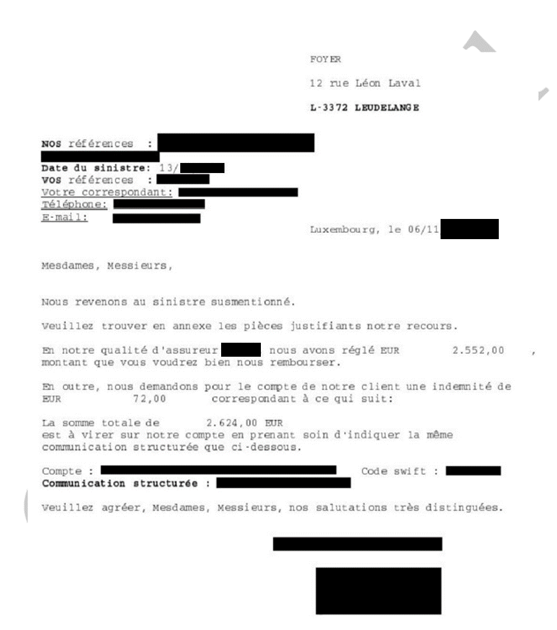
Processing large, unstructured documents required advanced tools, and proprietaries LLMs do not offer the requested level of security
+30
With more than 30 entities to extract, the combination of OCR + BERT/Mixtral 8x7B are not sufficient
+50
With more than 50 patterns of documents, Mixtral 8x7B is not able to generalize extraction
Proprietaries models expose vulnerabilities and are not compliant with Foyer security constraints.
Models must be locally hosted

Slide 63
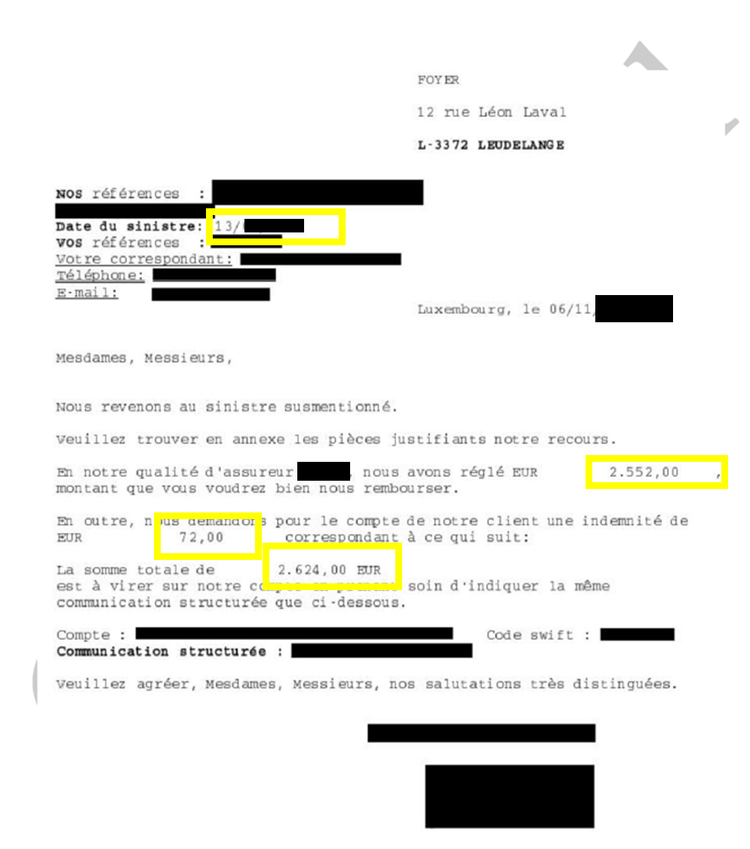
A mixture of Multimodal LLMs and RegEx allow to automate information extraction from co-insurance and "décompte" statements
Artificial Intelligence Models
Performance
Business Impact
Mixture of Multimodal LLM & RegEx
60% of the co-insurance and "décompte" statements received by indexers can be fully automated with 95% confidence interval
99%
60%
99% of the entities are extracted correctly
A finetuned 8B parameters Multimodal LLM, specialized over the entities extraction
OCR + Regex for other entities recognition
40% of the remaining co-insurance and settlement statements received by indexers can be semi-automated with human validation
40%

Slide 64




The technical Stack servicing automation
2x Junior Data Scientist (6 months)
BERT MLflow Python Mistral AI Large Language Model Hugging Face Llama 3.x
Donut 🍩

Slide 66

Automate ESG Responses from LPs surveys

Slide 67
Eurazeo, a leader in asset management and ESG integration, is facing increasing demand for accurate and detailed ESG reports
Increasing demands
Limited Partners (LPs) expect detailed and regular reports on ESG performance
Complex surveys
LPs send questionnaires covering hundreds of specific questions for each portfolio, with complex technical and regulatory requirements that comply with international standards such as SFDR, EU Taxonomy, etc.
>10 000 questions
Limited Partners collectively send over 10,000 questions annually to EURAZEO
10 minutes par question
The complexity of the responses requires meticulous work from Eurazeo's ESG teams, with 10 minutes per question, reaching up to 12.5 hours per survey

Slide 68
The deadlock of manual methods: an impossible equation between workload, speed, and accuracy in ESG responses
Risk
Diversity of surveys’ formats and specific requirements of LPs increase the likelihood of discrepancies in the quality of the responses
Risks of inconsistency
Risks of non-compliance
Shadow AI
Heterogeneous
Tight deadlines, limited resources
Completing an entire questionnaire takes around 12.5 hours, which increases the risk of delays, errors, or incomplete responses when multiple campaigns need to be managed simultaneously
Risk of non-compliance and delays: Meeting deadlines is critical to satisfy LPs, but the manual approach increases the risk of delays or incomplete responses
Manual

Slide 69
Adoption of an AI Tool to Automate ESG Responses
Artificial Intelligence Models
Performance
Business Impact
Reduction in the time required to answer a question
80% reduction in processing time per questionnaire, going from 12.5 hours to 2.5 hours with AI.
2mn
80%
GPT-4
AI answers a question in 2 minutes (vs. 10 minutes for a human)
90% accuracy rate
Scalability: Ability to handle thousands of questions simultaneously
Connection with Snowflake to process natural language queries
70%
70% of cost reduction with automation
Notes:
Outil disponible pour les experts métiers : Autonomie accrue et accès rapide aux données ESG pour des analyses approfondies.Conformité : Respect strict des normes ESG et des attentes des LPs, réduisant le risque de non-conformité.

Slide 70








Automated ESG questionnaire completion with AI engine
1x Senior Data Scientist (6 months) 1x Medior Data Scientist (6 months) 1x Advanced Full Stack Developer (3 months) 1x Expert Project Manager (6 months)
CI/CD Docker Flask GitLab Node.js NumPY Pandas Python SQL Prompt Streamlit Terraform

Slide 71

AMBULANCE handover DELAY PREDICTION

Slide 72
Keolis ship patients to hospital and often faces delays for the handover
Risk
Transfer optimization
Ambulances often face delays when handing over patients due to hospital inefficiencies, leading to idle vehicles and potential risks for patients
Increased Patient Harm: Delays in ambulance handovers can lead to patient harm, as timely medical interventions might be postponed. This can exacerbate health conditions and increase the risk of adverse outcomes
Operational Inefficiencies: Without predictive systems, hospitals may struggle with bottlenecks and overcrowding, leading to inefficient use of resources. This can result in longer wait times for patients and increased strain on healthcare staff
Seasonal effects
Use historical data on ambulance trips to train a machine learning model that predicts delays in patient handovers at hospitals
Various ranges of delays
Address the variability of delays across different hospitals and account for factors such as seasonality and hospital capacity

Slide 73


AKABI Implemented a PoC for handover delay prediction tool
Business Impact
Mean Absolute Error (MAE) of 5 minutes for the delays, corresponding to a prediction interval of 10 minutes
Optimization of Hospital Resources: Improving operational efficiency and reducing wait times for specialized care
Improvement in Patient Flow: Increasing hospital capacity and improving patient satisfaction
Cost Reduction: Using AI to anticipate care needs helps hospitals reduce the average length of hospital stays, freeing up resources for other patients
10 min
Integration of external data sources from OpenWeather and Waze routing API, with backend tools such as Azure SQL, Django, and scikit-learn could further improve it
Scaling the model to learn from multiple hospitals and incorporating additional data points like ambulance staff details and patient flow information to improve accuracy

Slide 74

Secure GPT & Generative AI
1x Junior Data Scientist (2 months)
Python
Azure DevOps
Azure AutoML
Random Forest
XGBoost

